Slide 1



2nd EURASIAN SILK ROAD
UNIVERSITIES CONVENTION
3-6June 2011
Developing a Robust Research Culture in Malaysia – a Case for UPM
Mohd Saleh Jaafar
Deputy Vice Chancellor for Research and Innovation
tncpi@putra.upm.edu.my

Slide 2
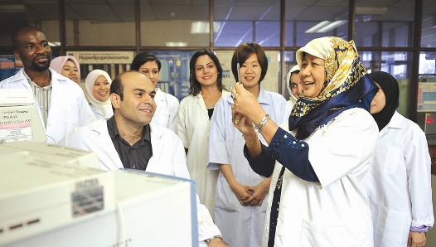
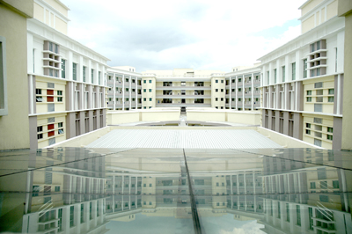
C O N T E N T
About UPM
Malaysian Research Assessment Instrument (MyRA)
UPM Strategic Initiatives
Proposed Networking

Slide 3
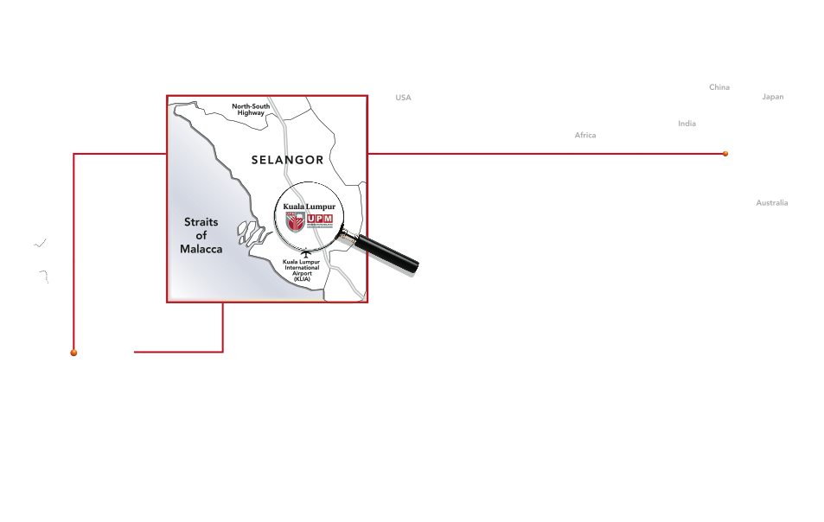
World Map
UPM
in the
Malaysia
UPM location:
  30 minutes from Kuala Lumpur International Airport
  30 Minutes from Kuala Lumpur City Center

Slide 4

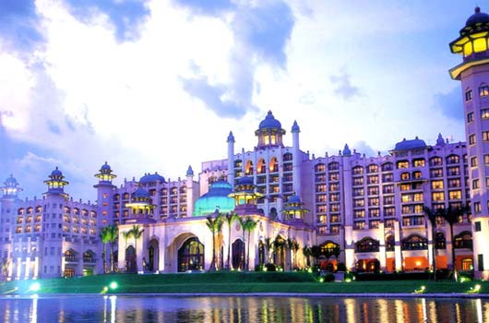
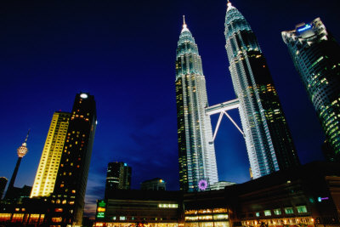
Nearest Place of Interest

Slide 5

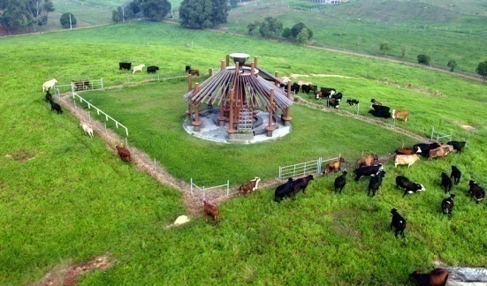
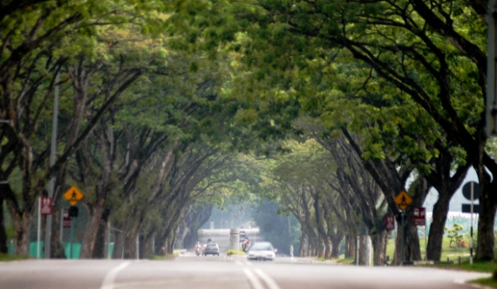

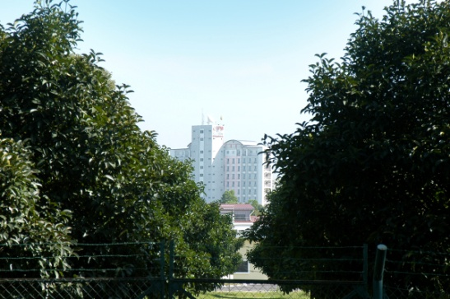
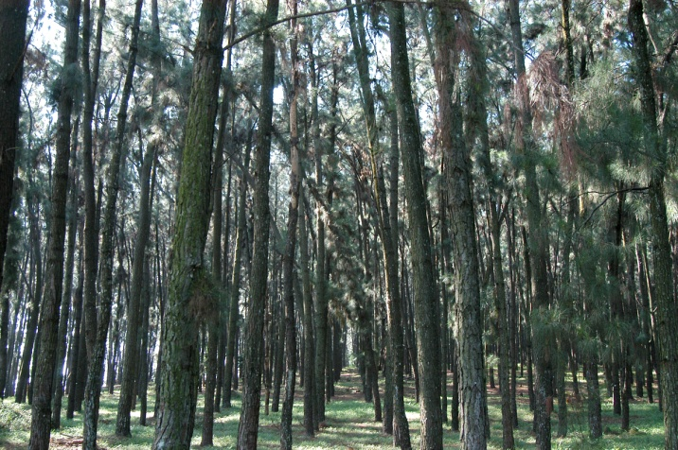


University Agricultural Park

Slide 6


Slide 7

Organizational Structure
VICE CHANCELLOR
DEPUTY VICE CHANCELLOR
Academic & International
DEPUTY VICE CHANCELLOR
Research & Innovation
DEPUTY VICE CHANCELLOR
Student Affairs
& Alumni
DEPUTY VICE CHANCELLOR
Industry & Community Relations
REGISTRAR
BURSAR
CHIEF
LIBRARIAN
FACULTY / INSTITUTE / SCHOOL / ACADEMY / CENTRE / DEPARTMENT / BRANCH CAMPUS
< BACK

Slide 8

UPM Quick Facts
Main Campus Size | 1,108.103 (hectare)
Total Students | 25, 857
Undergraduate Students | 15, 619
Post Graduate Students | 10, 238
International Students | 2, 675
Academic Staff | 1400
Facts & Figures
Campus Size
As of April 2011

Slide 9


Students from more than 60 countries
Algeria Brunei Canada Egypt Pakistan Sierra Leone Japan
France Ghana Iran Colombia Thailand Nigeria Myanmar
Korea Malawi Morocco Nepal Oman Philippines Turkey Sweden
United States Vietnam Yemen Zimbabwe Bahrain
Cameroon Ethiopia Fiji Island Germany India Laos Jordan
Uzbekistan Kenya Maldives Namibia Palestine Mongolia
Singapore Tanzania Malaysia Uganda Venezuela Syria Botswana China Gambia Indonesia Libya Mauritius Saudi Arabia Sudan Bangladesh Cambodia Iraq Mauritania Cote D’Ivoire Somalia Sri Lanka

Slide 10
PROGRAMMES OFFERED
16 Faculties, 2 Schools,
& 9 Institutes offering:
School of Graduate Studies
Graduate School of
Management
Institute of Bioscience
Institute of Advance
Technology
Institute of Gerontology
Institute of Mathematical
Research
Halal Product Research
Institute
Institute of Agricultural and
Food Policy Studies
Institute of Tropical
Forestry & Forest Product
Institute for Social Sciences
Studies
Institute of Tropical
Agriculture
Faculty of Agriculture
Faculty of Forestry
Faculty of Veterinary Medicine
Faculty of Economics &
Management
Faculty of Engineering
Faculty of Educational Studies
Faculty of Science
Faculty of Food Science &
Technology
Faculty of Human Ecology
Faculty of Modern Languages &
Communication
Faculty of Design & Architecture
Faculty of Computer Science &
Information Technology
Faculty of Biotechnology &
Biomolecular Sciences
Faculty of Environmental
Studies
Faculty of Agriculture & Food
Science (Bintulu Campus)
  7 Diploma programmes
  55 Bachelor programmes
  43 Master programs by Course Work
  More than 250 fields of study -Master and PhD by Thesis

Slide 11
MoU/MoA by Continents (Active)
Total of 90 MoU active until March 2011

Slide 12
INTERNATIONAL PARTNERSHIP
Co-Organizing
Academic Activities
(Conferences/Symposium/
Workshop and etc)
Curriculum
Development
Students Attachment/
Students Exchange
Publication of
Articles and Books
`Win-Win’
Projects
Staff Attachment/
Staff Exchange
Assessors/ Academic
Advisor for
Undergraduate
Programmes
External Examiners
for Postgraduate
Studies
Joint Research
Projects
Innovation &
Commercialization
Activities
Joint
Postgraduate
Supervision
Seeking for Students Mobility

Slide 13






Research Clusters
Agriculture
Food
Social
Science
Health
Cluster
Forestry &
Environment
Science,
Technology &
Engineering

Slide 14
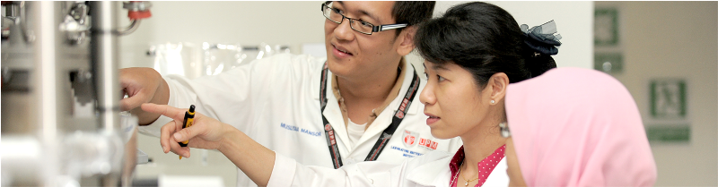
Outcome
Research Output
Outcome | 2006 | 2007 | 2008 | 2009 | 2010
Citation Indexed Journals | 459 | 763 | 1,137 | 1,809 | 1,889
Impact Factors | 270.5 | 392.9 | 503.7 | 900.2 | 1,160.1
Patents | No.
Granted | 56
Patents Filed | >400

Slide 15

Technology Oriented
Business Driven
Sustainable Development
Environmental Friendly
Robust R&D Culture?..
UPM was awarded a Research University status
in October 2006 by the Ministry of Higher Education, Malaysia
We are just starting……

Slide 16
Malaysian Research Assessment
Criteria
Quantity and Quality of Researchers
Quantity and Quality of Research
Quantity and Quality of Post Graduate Students
Income Generated through Consultancies
Innovation and Intellectual Properties
Networking and Linkages
Accredited Facilities

Slide 17
Building Research Culture
Ensure appropriate qualification of academic staff
Providing research grants
Incentives for publications
Incentives for commercialized products
Funds for networking and matching grants
Funds for Graduate students/ Post docs
Upgrade research facilities

Slide 18
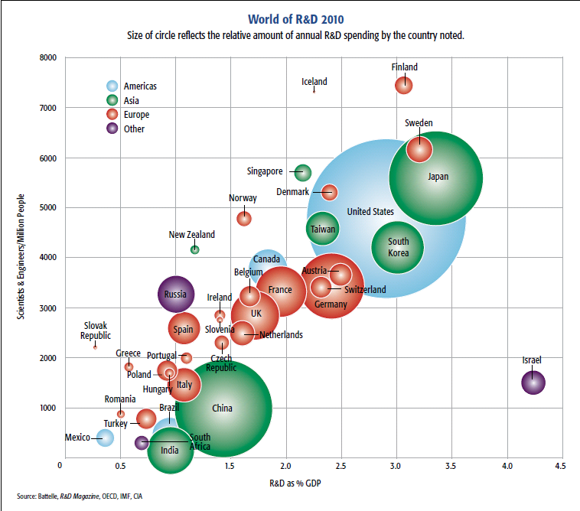

Scientist-engineers/million population
Where do we stand?
Research Grants
8000
6000
Singapore
Japan
4000
2000
Israel
0
1.5%
2.5%
3.5%
4.5%
R&D as % GDP
Source: Elsevier

Slide 19
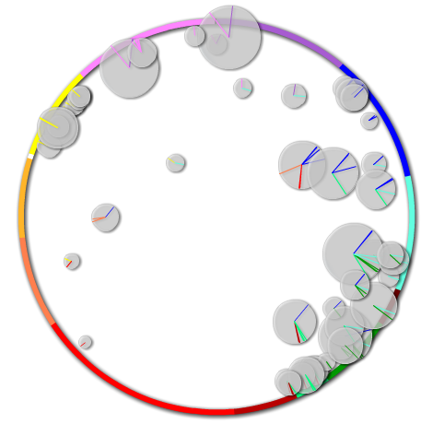
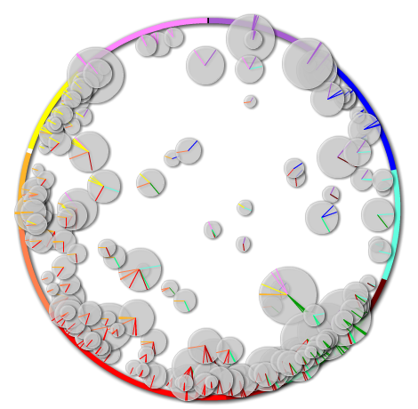
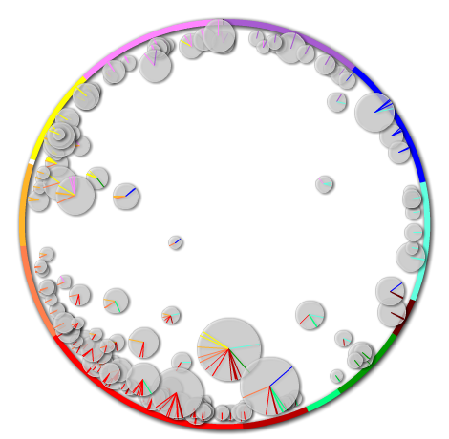
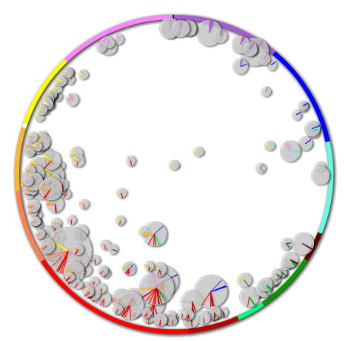
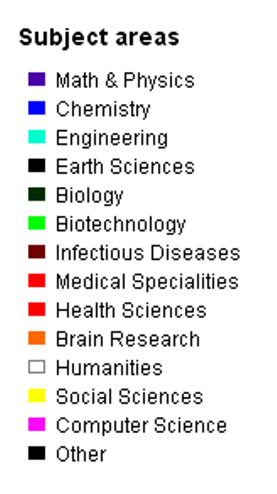
Distinctive & Emerging Competencies
2009
UPM
Cornell
53
COMPETENCIES
205
COMPETENCIES
Hong Kong
155
COMPETENCIES
Melbourne
214
COMPETENCIES

Slide 20
Where do we stand?
University | All years |  | 2007-Present
 | No. of Publications | H-Index | No. of Publications | H-Index
UPM | 9,293 | 53 | 5,888 | 20
Cornell | 94,465 | 357 | 18,653 | 90
Melbourne | 66,051 | 213 | 21,737 | 87
Hong Kong | 40,368 | 173 | 12,315 | 66

Slide 21
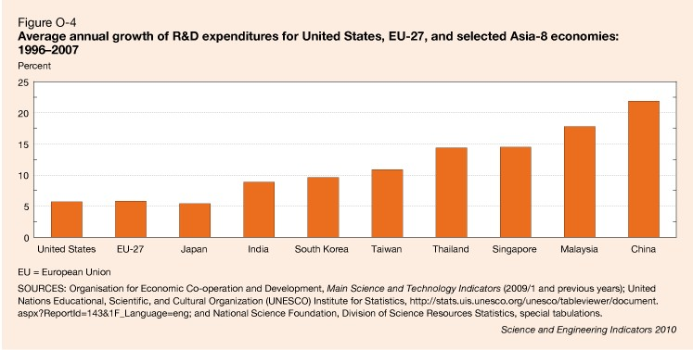

Percentage Increase in R&D
USA
India
Malaysia
China
Source: National Science Foundation

Slide 22
Increase in Publication (1957-2009)
Bright Future?
Increase in research grants
Exponential increase in publications
Qualified researchers >85% with PhD
Support for multidisciplinary and multi-institutional research
9,9601
(scopus data1957-2010)

Slide 23



Comparisons
Projection
(scopus data1957-2010)

Slide 24

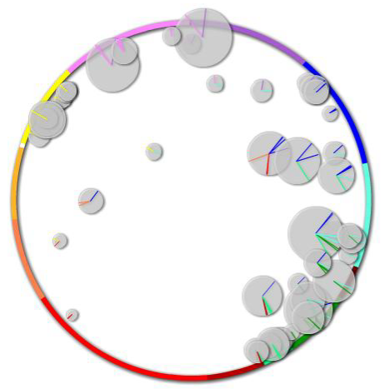
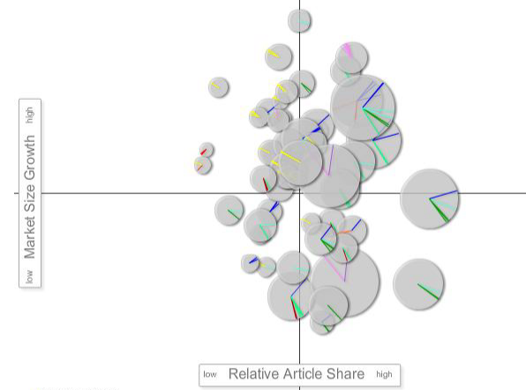
UPM Global Scival Spotlight
Visualization Matrix for UPM 2009
MOST in Blue Ocean and STAR region
EC29
DC5
EC21
EC51
QUESTION MARK
HIGH GROWTH AREA
LOW MARKET SHARE
STAR
HIGH GROWTH AREA
HIGH MARKET SHARE
EC19
DC13
EC40
EC45
EC27
EC14
EC36
EC24
EC48
EC25
EC39
EC48
DC2
EC28
EC47
EC35
EC43
DC6
EC38
EC22
DC13
DC7
DC12
DC11
EC48
EC49
DC9
EC32
DOG
LOW GROWTH AREA
LOW MARKET SHARE
EC32
BLUE OCEAN
LOW GROWTH AREA
HIGH MARKET SHARE
DC17
EC20
EC33
DC 10
EC 43
DC1
EC10
DC16
EC16
EC30
EC50
DC5
EC20
EC8
EC15
DC8
EC41
EC30
EC53
EC31
EC33
EC41
EC42
DC9
EC49
EC52
EC34
EC18
10 distinctive competencies and 43 emerging competencies (highest in Malaysia)

Slide 25
UPM STRATEGY MAP
Customer/Stakeholder’s Expectation
Innovative Workforce
Innovation Led Economy
Enhanced Quality of Life
Research Competitiveness (Quality & Quantity)
Research Commercialization
- Products &Technology Know How Licensing , Techno-preneur
Excellent Extension, Consultation and Employment
PROJECTS & INITIATIVES
Strategic International and Industry Alliances
PUTRA Science Park – Incubation center
Off-Shore Research and Development Centers
Inter-disciplinary Research in Niche Clusters
High-end and accredited facilities
Acquiring/ Establishing Teaching Hospital
Strengthening R&I and Services HICoE
Learning & Growth
HR Development, Selection, Deployment
Talent Management – 100 Top Scholars
Acquire and train R&D support personnel
MyPutra Cockpit
Value Management
Intellectual & Collaborative Culture
Governance and devolution of power
Financial
Financial Resources Optimization & Autonomy
Government Funds
UPM-Private Funding Initiatives

Slide 26
UPM Research Road Map 2011-2015
To be University of International Repute
2006 - 2010 | 2011-2014 | 2015
Increase critical mass (PI from 30 to 75%, PhD from 55 to 75%) Increased PG students Establish research cultures 300% increase in Impact Factors: 319 (2006) to 1,062 (2010) Research and Innovation incentives Establish Innovation and Commercialization Center | Talent Management & Top scholar program Curriculum on Innovation Strengthening Niche areas – Distinctive and Emerging Competencies 10 high-end and certified facilities 5 HICoE in Research and Services Incubation and technopreneur centers International & Industry matching | Sustainable research culture and output Increase IF to 4500 (1000% increase) 20 products & tech. know-how 20 companies and technopreneur 500% income increase from commercialization of R&D Community and Industry reference centers
Laying the Foundation
Strengthening phase
Attaining excellence

Slide 27
Examples of High Impact Projects
Integrated Solution for National Food Security
Halal Innovation and Certification/ Service Center
Pre-clinical Animal Testing Center
Aerospace Manufacturing and Innovation Center
Green Technology and Innovation Center
Super Critical Fluid Extraction (SEFE) Center
Medical Imaging and Diagnostic Center
Science Park and Center for Technopreneur
Teaching Hospital
Marine Science Center

Slide 28
Opportunities for Networking
Visiting researchers/ scholars
Students / Post Docs recruitment
Joint supervision for research students
Matching research grants
Commercializing IPs
Other Opportunities
  Undergraduate summer programs
  Credit transfer programs (Malaysia is a WA member country)

Slide 29
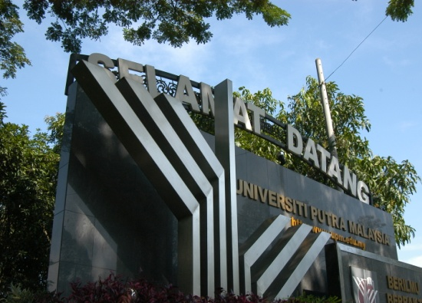

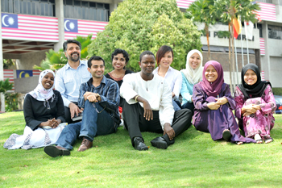
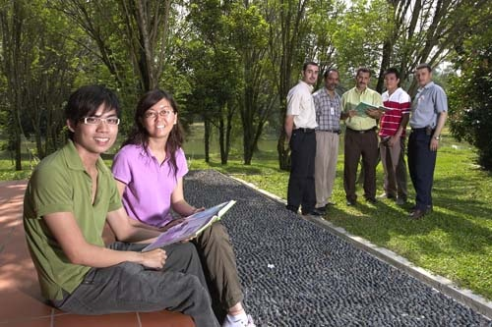

Thank You

