Slide 1




MODERN HIGH SCHOOL DIDACTICS
Notes:
I am honored and delighted to deliver the presentation on behalf of the Kherson state university’ administration and personally Vice-Rector prof. Spivakovsky at this international conference. I would like to thank the President of Ataturk University Prof., Dr. Hikmet Kochak for kind hospitality and generous support in making this event possible. I would also like to thank the staff of the Ataturk University for their hard work in organizing this forum.
I am going to focus on some didactic aspects of higher education which have already been undertaken at KSU to overcome the transition period and which are aimed at improving the educational process.

Slide 2






A key challenges facing the modern system of higher education are as follows:
A teacher looses a monopoly on a body of
knowledge
Students get unlimited access
to information resources
Phenomenon of “red shift” within the broadening
of informative and communicative space
Qualitative and quantitative differences in ICT-
competences of younger and older generations
A teacher has lost an exclusive domain of knowledge
Students have received unlimited access to information resources
Phenomenon of “red replacement” in broadening of information and communication environment
Qualitative and quantitative differences in ICT-competences of younger and senior generations
Notes:
Higher institutions today are surrounded by issues that have developed as a result of the transformation of societies from the industrial to the information age. Accompanying these are a set challenges that universities have to overcome in order to survive or risk being obsolete.

Slide 3



New teaching technologies are characterized by the following aspects:
1 STAGE: SUBJECT-OBJECT DIDACTICS
  Subject-object
  Linear
  Megabyte
Filling up
Teacher
Student
with knowledge
Full
2 STAGE: SUBJECT- SUBJECT DIDACTICS
  Subject-subject
  Two-dimensional
  Gigabyte
Teacher
Student
partners
Full
Teacher
Student
partners
3 STAGE: THREE-SUBJECTIVE DIDACTICS
  Three-subjective
  Three-dimensional
  Terabyte
Environment
Notes:
The historical review of the high educational didactics shows that the first stage – the beginning of the XXth century – is characterized by the linear communication between a teacher and a student with the whole amount of information equal to megabyte. The second stage – the second half of the XXth c. – presupposes two dimensional relations with the information of gigabyte. The third one reflects the contemporary state of educational process which comprises the ICT and thus widens up the informative space to a terabyte.
Technological advances have brought fundamental changes to many aspects of our lives and removed barriers among cities and countries. Modern universities need to make decisions from a global perspective in order to fully grasp the opportunities available. Indeed, we are living in an extremely competitive world, and our students should be able to create and apply knowledge in an innovative way to strive for success. Thus, our basic strategy is to enhance the quality of our education.

Slide 4
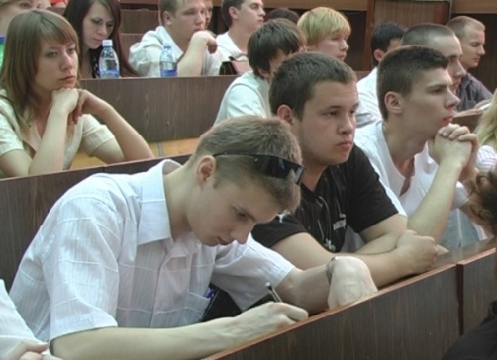
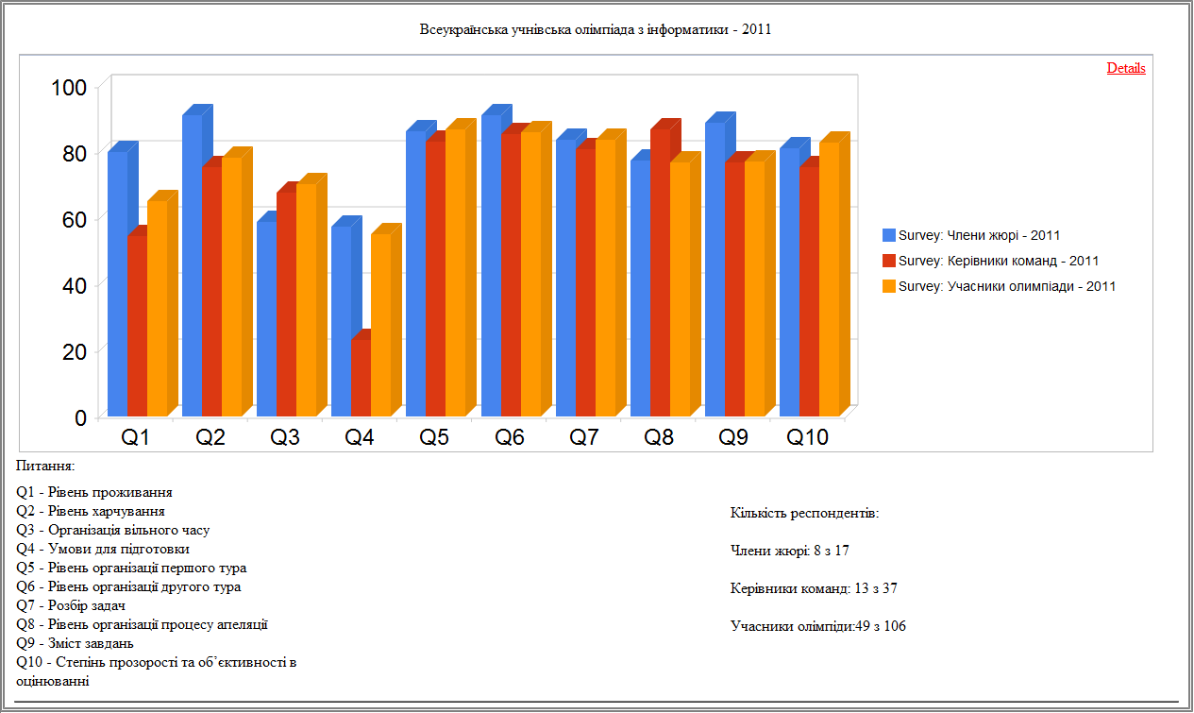

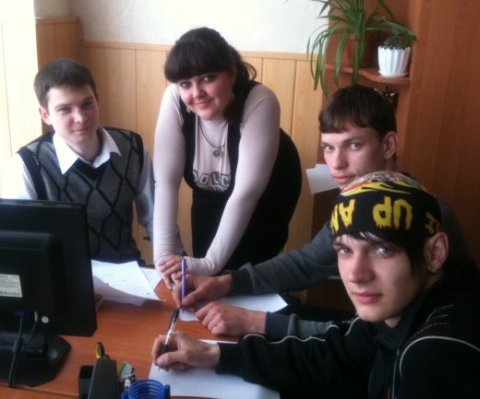


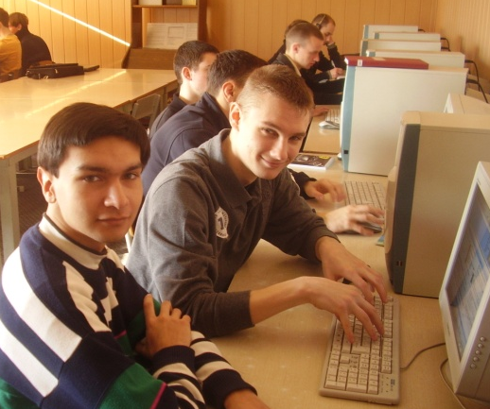

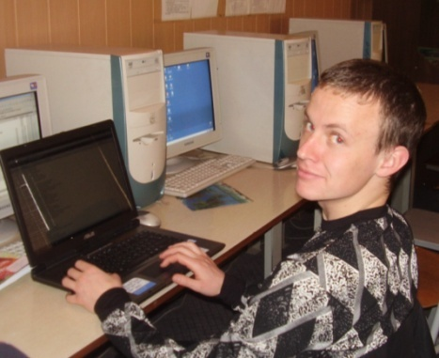
Basic principles of education at modern
Universities and KSU in particular
University is a corporation for serving educational issues.
Students motivation is a key to the new career options
University is a provider of global educational services.
Up-to-date informative and communicative technologies are for educational process participants
Notes:
Institutions and KSU in particular are expected to equip graduates with the right attitude, adequate knowledge and a set of relevant skills for the information age and who will be able to function well in the knowledge-based economy within the context of globalization and lifelong learning.

Slide 5
Educational Process
Education as a concept
2
Competitiveness of education
3
The functions of a teacher and a student within the tree-dimension system
4
The development of training specifications that correlate with the new career options
1
Notes:
Each institution should find the balance of education, research and innovation which is best suited to its role in its region or country. This will necessarily mean a differentiated approach. The aim is to create a framework within which universities can become stronger players in the global knowledge society and economy. The primary goal must be to achieve excellence in the teaching and research functions of universities.

Slide 6
Educational process
5
The appliance of adequate teaching techniques which face the world changing challenges
6
The importance of feedback in the informative and communicative educational process
7
The appliance of educational strategies while forming the training specifications
8
Motivation as a key component in educational process
Notes:
It can contribute to improving University’s capacity for scientific education, research and innovation, while providing an innovative model to inspire and drive change in existing model of education, in particular by encouraging trans-disciplinarity and developing the strong partnerships with business that will ensure its relevance.

Slide 7

Educational principles
Principle of correlation between a student’s educational skills and career options
Principle of free access to educational resources
Principle of a person social adaptation to the up-to-date informative and communicative technologies
Principle of educational resources integration
Innovative educational principles
Principle of harmonization with the global Net system
Principle of knowledge globalization
Principle of on / off- line model in educational communication
Principle of WEB-multimedia presentation of educational information
Principle of WEB- global educational groups
Principle of multilinguism in the educational process
7
Notes:
The need to advance in bringing about the modernization of universities, addressing their interlinked roles in education, research and innovation, as a key element of Eurasian's drive to create a knowledge-based society and economy and improve its competitiveness.
For this purpose, alongside the fundamental local, regional and national roots of universities, the Eurasian framework is becoming increasingly important. This dimension offers the potential benefits of larger scale operation, greater diversity and intellectual richness of resources, plus opportunities for cooperation and competition between institutions.

Slide 8


Motivation
for active learning
The role of a teacher in students’ motivation
The development of competitiveness among the students
The appliance of analytical trait scoring on a feedback ground
Open access to the informative and communicative resources while active learning
Notes:
It is important to make correct assessments of opportunities, risks and trends so as to enable us to focus on building on those elements that provide the foundations for sustainable performance. It should go beyond being concerned with issues of immediate term and immediate relevance. A
longer-term perspective is required, looking beyond the immediate term and immediate interests.

Slide 9
Teacher’s activities for successful educational process
Traditional teaching techniques
Lecture deliverance
Analytical traits scoring of students
Teacher’s academic activities
Seminars and workshops conducting
Academic communication in the educational process
Access to the scientific research database
Pre-stage of lecture deliverance
Appearance of the new role-models
Academic activity of the University staff involving the informative and communicative techniques
Pre-stage of seminars and workshops conducting
Feedback of analytical traits scoring based on the different role-models
Notes:
In managing the situation, sustainability requires that we pay attention to the entire cycle and that takes into account context and perspective. Teacher’s activities are centered around the problems, needs and conditions of a nation and its society. As it is seen from the scheme, with rapid social changes brought by globalization we need to consistently relook and re-examine the contents of programs and the methodology of teaching. A university therefore must be staffed with high caliber academicians to maintain a high standard of teaching and research involving the informative and communicative technologies.

Slide 10
Forms of educational activities in the University
The variety of seminars and workshops using the informative and communicative techniques
Appliance of compensatory forms in educational process
Access to the open systems of education
Appliance of distance learning at the University
Notes:
Managing academic human resource is therefore, a very challenging task. In spite of the difficulties any university faces nowadays, KSU today is on the way to solve at least some of them. The options in front of you are already realized at our University and can be presented in different forms of educational activities. For example, international collaboration in joint research can also go a long way in the internationalization of universities. And here the advent of ICT has facilitated greatly such collaborative efforts. During last 5 years KSU has developed the partnership with the following universities: Sophia-Antipolis (France), The University of Granada (Spain), The University of Glasgow (Caledonia) (Gr.Br.), University of New York State (USA), University of Klagenfurt (Austria), Royal Technical University (Sweden).

Slide 11
Modern didactic challenges in transition period
The usage of licensed educational programs
The protection of scientific and research database by copyright in the Internet usage
The phenomenon of plagiarism and protection of copyright
The problem of the university staff adaptation to the modern technological realias
Problem of academic group forming
!
Notes:
The traditional roles between a teacher and a student are no longer adequate for any university that wish to improve its performance. Unfortunately, the rich heritage of our universities of all ages sometimes translates into a robust resistance to change. Academic staff needs to become more strategically involved with the achievement of a university goals or its vision. They have to become the champions of change and recognize their functions so that they move from a reactive, process-oriented, and compliance focus to being a productive, results-oriented, consulting-oriented strategic partner.

Slide 12
THANK YOU FOR
ATTENTION !

