Slide 1

The Priority of Research and Doctoral School
Nino Zhvania
Head of the Quality Assurance Office

Slide 2
Education Reforms in Georgia – Some Crucial National Achievements
Joining the Bologna Process in 2005;
Three levels of higher education: Bachelors, Masters and PhD;
The national framework of qualification descriptors aligned with the Dublin Descriptors and national research findings;
External criteria of quality assurance for higher education;
The legislative provision for the amalgamation of research and higher education.
Notes:
Stakeholders: academics, employers, graduates, students.
10 areas – 7 universities (ISU among the participants)
Total number of respondents: 2629

Slide 3
Ilia State University
Our belief
Strong research universities and a unity of well-accomplished, highly achieving individuals constitute the basis for knowledge economy.
Our mission
Creation of advantageous opportunities for knowledge economy.
We prioritize
basic and applied research,
participation in international research projects,
research on Georgia.
Notes:
Knowledge economy versus crude-resource based economy.

Slide 4
The Georgian Education Reforms – Ilia State University
Experience of administration and enhancement of academic programs at the three levels of study.
Involvement of research institutes in the graduate level training (22 research institutes);
Priority for internationalization;
Interdisciplinary;
First cycle of institutional accreditation passed. Preparation for the second cycle of program accreditation.

Slide 5
ISU Doctoral School Quality –
Development of a Doctoral School
Code of Practice
Tempus Project
Georgia, Ukraine, the Netherlands, Great Britain
Notes:
The Code of Practice is not a single document but the unity of internal and external regulations, statutes, rules and practices determining the teaching/learning, research, supervision and quality enhancement exercised within the University.

Slide 6
Best Practice
Chicago Style Based
Twinning
Aligned with the Dublin Descriptors
Impact Factor and Peer-review
Aligned with NQD 3rd cycle

Slide 7
National Qualification Descriptors – 3rd Cycle
Dublin Descriptors
Knowledge and Understanding: [includes] a systematic understanding of their field of study and mastery of the methods of research associated with that field
Applying knowledge and understanding: [is in the context of] a contribution that extends the frontier of knowledge by developing a substantial body of work some of which merits national or international refereed publication
National Qualification Descriptors
Knowledge and Awareness: demonstrates profound, systematic and research-based knowledge, that allows for performance on the international peer-reviewed journal standards; has a full mastery of field-specific theory and research methods
Knowledge Application Skill: Independently plans, implements and supervises original research; has a capacity to develop innovative research and analytical methods and approaches focused on new knowledge generation and presented in international peer-reviewed publications

Slide 8
National Qualification Descriptors – 3rd Cycle
Dublin Descriptors
Making Judgments: [requires being] capable of critical analysis, evaluation complex ideas.
Communication: with their peers, the larger scholarly community and with society in (dialogue) about their areas of expertise (broad scope)
National Qualification Descriptors
Critical Thinking Skills: has a capacity to critically analyze, synthesis and assess new, complex and contrasting ideas and approaches thus supporting the development of new methods; independently makes correct and effective problem-solving decisions.
Communication Skills: has a capacity to deliver complex information to colleagues and society with the consideration of their background; communicates in world languages.

Slide 9
National Qualification Descriptors – 3rd Cycle
Dublin Descriptors
Learning Skills: expected to be able to promote, within academic and professional contexts, technological, social or cultural advancement.
National Qualification Descriptors
Learning Skills: Has the capacity to plan and manage learning processes.
Values/Attitudes: Studies innovative approaches to the establishment of values.

Slide 10
Involvement of the research institutes/centers/labs
Research projects conducted within the framework of a PhD program constitute an integral part of research conducted by research institutes, centers and laboratories and are strategically planned.
ISU Doctoral School School Statute

Slide 11
Regulations and Criteria for degree award
Students are awarded PhD degrees if they:
- have demonstrated systematic knowledge in their fields of studies and research;
- have displayed efficient skills in research planning and implementation;
- have delivered original research that contributes to knowledge generation and is publishable;
- is equipped with critical thinking skills;
- is equipped with communication skills for the delivery of research issues within the scientific community and general public.
ISU Doctoral School Statute

Slide 12
Plagiarism
Members of the University faculty and graduate students are responsible for preserving university reputation and prestige. In order to fulfill this goal they shall be aware of and comply with the Code of Academic Ethics of the university.
University members shall not use and publicize results of intellectual work of others, texts, ideas, concepts, visual and audio materials as well as any kind of data without proper indication of the author (Plagiarism)
University members shall not reuse their own work without citing the original source (Self-Plagiarism)
University members shall not falsify data, information or citations in the academic work (Falsification)
A case of misconduct is reported to the QA
Commission
Where plagiarism is proved:
Written warning is issued and subsequent review of all articles for plagiarism or falsification is conducted;
Monitoring of thereafter work;
Contract termination;
Expulsion

Slide 13
Enhancing internationalization
Support of Journal Publications
Thomson Scientific
EBSCO HOST
SCOPUS
ERIH
Conference funding
www.thomsonscientific.com
http://search.ebscohost.com/
http://www.scopus.com/home.url
http://www.esf.org/research-areas/humanities.html

Slide 14
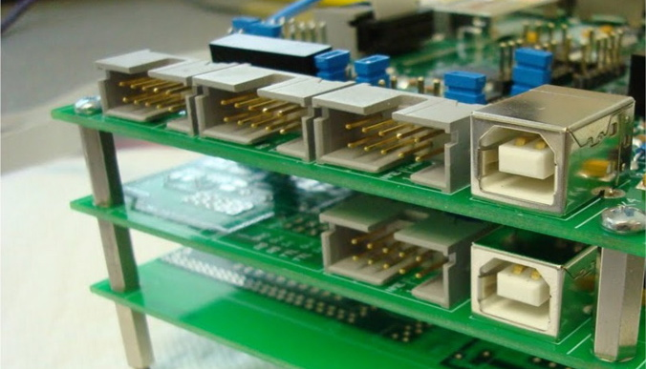
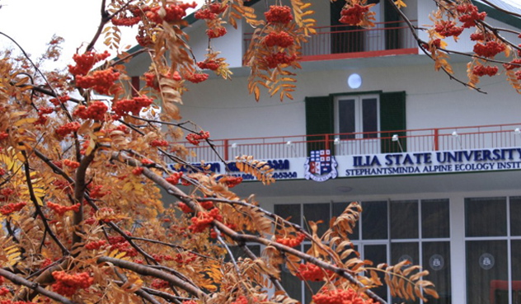
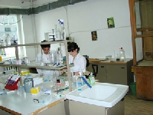


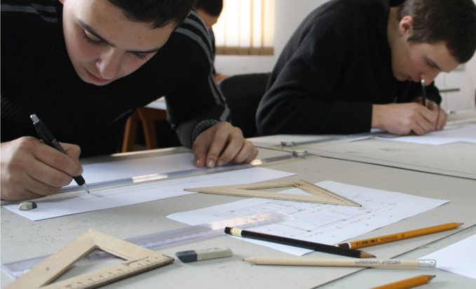
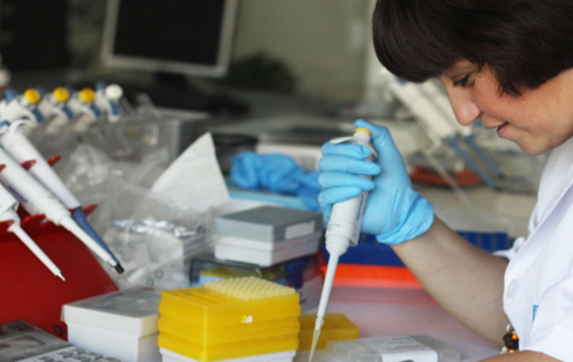
Thank you!

