Slide 1

Abdelmalek Essaadi University
University reform in Morocco
Pr. Ahmed El Moussaoui
Vice Président
Atatuk University, ESRUC,
June 3 to 6, 2011
www.uae.ma

Slide 2
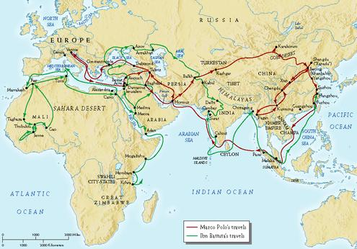
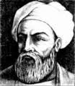
Ibn Batuta Silk Road,

Slide 3
University’s traditions in the 19th century
Pr. Rethy Chhem, University of Western Ontario (Cambodia)
The French model: “obedience to the great master” (Low enacted on 10 Mai 1806)
  Train bureaucrats for administration and officers for army
The German model: ” Freedom is, but the possibility of a various and indefinite activity” (Humbolt, 1908)
  Conduct studies and research to their personnel will
The British model: “discoveries verified and perfected” (Newman, 1951)
  Developing mental abilities, learn by research

Slide 4
21st century trends
Globalisation
Mass higher education
Commercialisation and alternate sources
ICT: Internet and social media

Slide 5
Best Universities
Objective: ed+research+ exploitation of K
Role: Creating value
Method: interdisciplinary and scientific
Creating: Professionals+scientists+entrepreneurs
Orientation: Global
Language: English
Organisation: University Institutes
Management: Corporate and professional
Pr. Rethy Chhem, University of Western Ontario

Slide 6
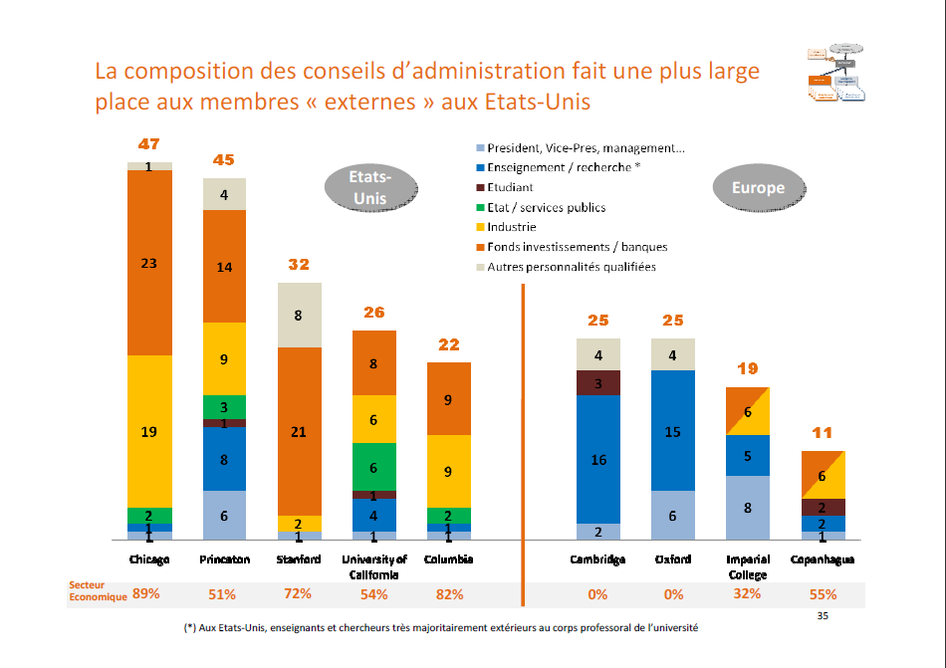
L’excellence universitaire : leçons des expériences internationales
Philippe Aghion, janvier 2010.

Slide 7

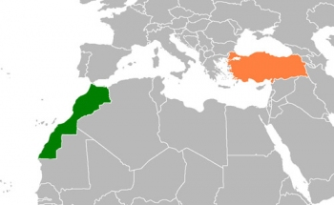
University reform in Morocco
31 millions inhabitants
15 universities, + 2 private
270 000 students; 12 000 professors

Slide 8
University reform in Morocco
1999: National Committee on Education and training
2000: Law for reorganizing universities : autonomy
New procedure to choose presidents
2003: Pedagogic reform :LMD
2008: Research organization
2009: Agreement Ministry – University
“Plan d’Urgence 2009-2012” : annual report

Slide 9
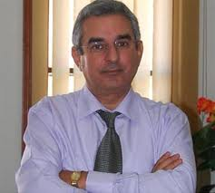
Abdelmalek Essaâdi University
North of Morocco : Tangier-Tetuan Region
29 000 students; 741 Professors ; 465 administrative
Sciences, arts, law, management, economics
Medicine, pharmacy and dental faculties soon (2013)
Excellency in energy and ICT
Cooperation : EU, Spain, France…
President
Houdaifa AMEZIANE

Slide 10
Priorities of Governance
Having decisions accepted and implemented ;
Communicate about the decision making process and about decisions;
Communicate to every body: students, administrative, staff, faculties members, civil society...: websites, journals, press, radio, TV...
Reinforce the adherence to the university by organizing common activities and developing INTRANET ;
Introduce quality concept.

Slide 11
Apply the new pedagogical reform (LMD)
Implement the academic mission and formulate new courses, diplomas and assure quality and norms ;
Suggest new proper diplomas of the university and found new clients ;
Contribute to the national effort to perform national degree course ;
New role of pedagogical commissions and organizations of diverse groups ;
Introduce evaluation methods and culture ;
Establish bridges between disciplines ;
Develop new e-learning methods and purchase necessary equipments ;
Develop continuous education programs.

Slide 12
Best reorganization of research
New research policy : structuring ;
Activate the “Doctorate Centers”;
Develop more link between Research and lecturing ;
Give more interest to students in Doctorate Program : annual research meeting ;
Reinforce the role of the « interface » ;
Optimize equipments ;
Finding external resources ;
Online organization and accreditation of new research structures “Sirech”;
Publishing annual research activities report.

Slide 13
Best reorganization of research
Training to manage international research program ;
Reinforce the practice of English language ;
Special interest to the research in the fields of social sciences and humanities ;
Training to conduct negotiation and contracts ;
Finding and managing scholarships for students.

Slide 14
To conclude
Our priorities are multiple but they all converge to increase the credibility of Moroccan high educational system and prepare young people to be a good citizen able to lead and serve the country in the global context.
« Don’t ask what your country gives to you but ask yourself what you are giving to your country ».
His Majesty King Mohammed VI

Slide 15
THANK YOU FOR
YOUR ATTENTION

