Slide 1
Discovering Creativity in Higher Education
Ali Caglar GULLUCE, Ph.D
Open Education Faculty

Slide 2
CONCEPTUAL FRAMEWORK
Tendency to generate or recognize ideas, alternatives, or possibilities that may be useful in solving problems, communicating with others, and entertaining ourselves and others.

Slide 3
Three reasons to be creative:
  1- need for novel, varied, and complex stimulation
  2- need to communicate ideas and values
  3- need to solve problems

Slide 4
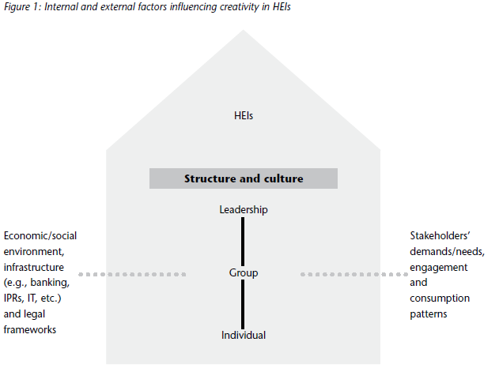

Slide 5
Internal organisation: structures and culture

Slide 6
External environment
the three T’s:
Technology,
Talent and
Tolerance.

Slide 7
Core characteristics of Creativity
Originality:
Appropriateness:
Future orientation:
Problem-solving ability:

Slide 8
KEY RECOMMENDATIONS
Structured exchanges among disciplines
Diversity within institutions
“being one step ahead” of the times
learning organisation
institutional structures aiming at balancing stability with flexibility
institutional leadership

