Slide 1


The Extend and Impact of Governance in Higher Education
Ali Caglar GULLUCE
Ataturk University

Slide 2


GOVERNANCE
the process of decision-making and the process by which decisions are implemented (or not implemented)
the exercise of political authority and the use of institutional resources to manage society's problems and affairs.
the use of institutions, structures of authority and even collaboration to allocate resources and coordinate or control activity in society or the economy.

Slide 3

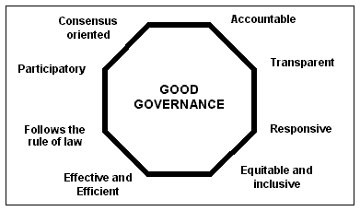
Characteristics of Good Governance

Slide 4

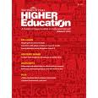
Importance of Governance in Higher Education Institutions
Preparation for the labour market;
Preparation for the life as active citizens in a democratic society;
Personal development
Maintenance and develoment of a broad, advanced knowledge base.
quality culture
flexibility
social cohesion

Slide 5


AUTONOMY, ACCCOUNTABILITY AND FLEXIBILITY
Challenges of H.E
increasing efficiency and effectiveness;
seeking additional and diversified funding sources;
adjusting to changing coordination mechanisms (state/universities) aimed at marketization;
competition and performance-based funding;
adjusting to the emerging knowledge-driven economy.

Slide 6


Degree of Autonomy
the regulation of student places (number of selection of students)
the right to start new programmes
the university’s personnel policy (especially academic staff salary scales)
the use of budget surplus at the end of the fiscal year
decisions to develop university facilities or new property
membership of external stakeholders in the university’s main governing bodies.

Slide 7


Accountability
the composition and powers of the governing body
strategic planning
academic quality assurance
government financial audit

Slide 8



RECOMMENDATIONS
a non-profit legal entity status
streamlining of bureaucracy and old-fashioned governance
Within limits, universities should have the right to charge tuition from students
Accountability with full financial autonomy

Slide 9


Quality assessment by international peer reviews
International benchmarking
Focusing in specific academic fields
Long-term partnership with alumni, regional authorities

Slide 10



