Slide 1
“ WELCOME “
Notes:
Before I began, I wish to publicly thank President Prof.Dr. Hikmet KOÇAK and his collegeagues for the invitation to meet with you and talk about a theme that has become, to paraphrase J.G. Hamann, "the bone that I continually gnaw on" as a new founding president. This topic is important to me because I believe that new understandings about New Dynamics and Trends in Higher Education may contribute towards an improvement in our ability to work together with peoples of diverse backgrounds in order to create a more dynamic, inclusive, and world-class universities

Slide 2
New Dynamics and Trends in Global Higher Education
1st Eurasian Silk Road Universities Convention
May 28-31, 2010, Erzurum
İbrahim Özdemir, Ph.D.
President, Gazikent University
Notes:
Before I began, I wish to publicly thank President Prof.Dr. Hikmet KOÇAK and his collegeagues for the invitation to meet with you and talk about a theme that has become, to paraphrase J.G. Hamann, "the bone that I continually gnaw on" as a new founding president. This topic is important to me because I believe that new understandings about New Dynamics and Trends in Higher Education may contribute towards an improvement in our ability to work together with peoples of diverse backgrounds in order to create a more dynamic, inclusive, and world-class universities

Slide 3
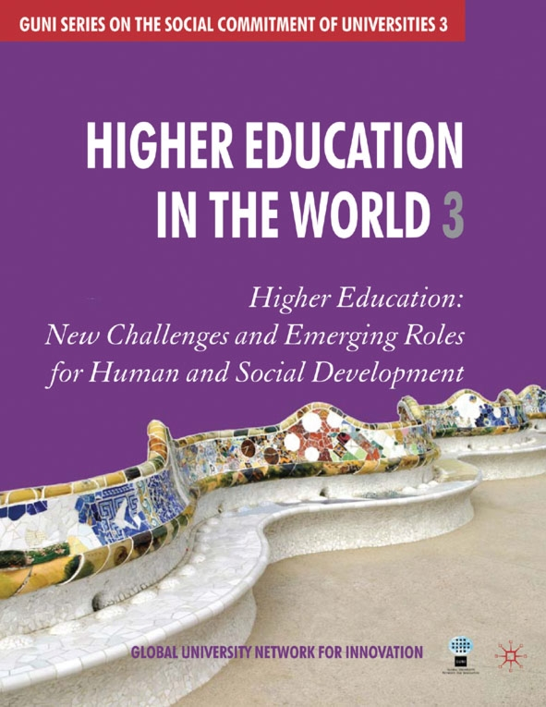
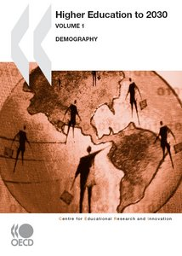
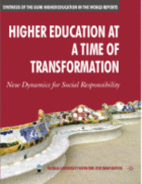
UNESCO & OECD on Higher Education

Slide 4
GUNI Report "Higher Education in the World"
The Report is a collective work published as part of the GUNI series on the social commitment of universities.
It is the result of a global and regional analysis of higher education in the world.
the Report reflects on the key issues and challenges facing higher education and its institutions in the 21st century.
It includes a Delphi poll in which key experts and practitioners giving their views on the subject, and contains supporting statistics, analytical maps and detailed bibliography.
Notes:
The Global University Network for Innovation - GUNI is composed of the UNESCO Chairs in Higher Education, higher education institutions, research centers and networks related to innovation and the social committment of higher education. 179 institutions from 68 countries are GUNI members.

Slide 5
UNESCO’s 2009 World Conference on Higher Education, (Paris, 5-8 July 2009).
Conference gathered over 1,000 participants from around 150 countries at UNESCO Headquarters over four days.
Ministers, university rectors, faculty, students and key representatives of the private sector as well as regional and multilateral institutions debated a wide range of issues including the impact of globalization on higher education, social responsibility, academic freedom, research and financing.

Slide 6
Key drivers of a 21st century academic "revolution"
Rising demand and massification
Diversification of providers and methods
Private provision
Distance education
Quality assurance
Cross-border Higher Education
Teacher Education
Academic profession
Notes:
Key drivers of a 21st century academic "revolution" are identified in a trend report produced for this week's UNESCO World Conference on Higher Education. The drivers are the massification of tertiary systems everywhere, the 'public good' versus 'private good' debate, the impacts of information and communications technology, and the rise of the knowledge economy and globalisation. All major changes in higher education stem in one way or another from these motivating forces, the report's authors say.

Slide 7
Background of the World Conference
To express its global coverage and give voice to regional and national specificities, the World Conference was preceded by six regional conferences.
They were held in Cartagena de Indias for Latin America and the Caribbean; Macau for East Asia and the Pacific; Dakar for Africa; New Delhi for South Asia; Bucharest for Europe and North America; and Cairo for the Arab States.

Slide 8
Demand and Massification
The first is rising demand. Higher education’s role in constructing the knowledge society is now acknowledged by all.
University degrees and diplomas have become passports to a good future and the demand for higher education has been growing rapidly.
Notes:
The nature of the challenge is clear when you create a triangle of vectors. With traditional methods of face-to-face teaching this is an iron triangle. You want to stretch the triangle like this to give greater access, higher quality and lower costs. But you can’t!
Try extending access by packing more students into each classroom and you will be accused of damaging quality. Try improving quality with better learning resources and the cost will go up. Try cutting costs and you will endanger both access and quality.
This iron triangle has hindered the expansion of education throughout history. It has created in the public mind – and probably in your own thinking – an insidious link between quality and exclusivity. This link still drives the admission policies of many universities, which define their quality by the people they exclude.
But today there is good news. Thanks to globalisation successive waves of technology are sweeping the world – and technology can transform the iron triangle into a flexible triangle. By using technology you can achieve wider access, higher quality and lower cost all at the same time. This is a revolution – it has never happened before.

Slide 9
Rising demand and massification/2
Globally, age participation rates in higher education have grown from 19% in 2000 to 26% in 2007.
There were 150.6 million students enrolled in tertiary education worldwide in 2007, which represents a 53% increase over 2000.
In low income countries these percentages were much lower and rose from 5% in 2000 to a modest 7% in 2007. This means we can expect continuing rapid growth in those countries.

Slide 10
Demographics is another driving force
Last year the OECD identified key demographic trends up until 2030 that appear to prevail globally in higher education. They are:
*Student participation and systems will continue to expand.
* Women will form the majority of student populations in most developed countries and their participation will increase everywhere.
* The student population will become more varied, including more international, older and part-time students.

Slide 11
Demographics/2
* The social base in higher education will continue to broaden.
* Attitudes and policies relating to access will become more central to national debates.
* The academic profession will become more internationally oriented and more mobile but will remain structured according to national circumstances.
* Academic activities and roles will become more diversified and specialised, and subject to varied employment contracts.

Slide 12
Demographics/3
* In developing countries, the need for more lecturers will mean that academic qualifications, already rather low, might not improve much and reliance on part-time staff will continue.
"Academic mobility is another hallmark of the global age”.
There are more than 2.5 million international students, though no reliable statistics for academics teaching abroad.

Slide 13
Diversification of providers and methods
It will not be possible to satisfy this rising demand, especially in developing countries, by relying on traditional approaches based solely on public universities.
A multitude of new providers of higher education is emerging.
A major recent trend is the creation of so-called ‘World-Class’ Universities.

Slide 14
Private provision
Private higher education is now the fastest growing sub-sector and some 30% of students are enrolled in private higher education institutions globally.
Some countries (Japan, South Korea) enrol 80% of their students in private higher education institutions and in parts of Latin America these percentages reach 50%.
For-profit higher education is also growing and developing.
The Conference stressed the importance of including the private sector in all quality assurance arrangements.

Slide 15
Distance Education
Modes of teaching and learning are also changing.
Applications of ICTs have impacted higher education significantly.
Open universities are multiplying around the world and are increasingly powerful players in national higher education systems.
These institutions are an important response to the challenge of scaling up higher education in response to growing demand.

Slide 16
Cross-border Higher Education
As defined by the 2005 UNESCO-OECD Guidelines for Quality Provision in Cross-border Higher Education, the term designates higher education that occurs when ‘the teacher, student, programme, institution/provider or course materials cross national jurisdictional borders’.
Cross-border higher education can take different forms, ranging from branch campuses and franchises of universities offering courses abroad to eLearning across borders.

Slide 17
Quality Assurance
Quality assurance – and especially the internationalisation of quality assurance – is one of the most striking new developments since UNESCO held its previous World Conference on Higher Education in 1998.
This new emphasis on QA was reflected not only in the conference Communiqué but also in both political and academic debates during the Conference.

Slide 18
Quality Assurance/2
The Indian Minister of Human Resource Development expressed his approach to internationalising quality assurance rather well:
“The globalisation of higher education has added newer challenges in terms of quality assurance system, issues of mutual recognition and equivalence of degrees and transparency in the regulatory structures of national systems of higher education. (…)
Quality Assurance Systems should encourage effective learning processes which are adapted to the needs of various categories of learners.
The systems should encompass not merely conventional programmes in higher education but also the borderless, private and continuing education.”

Slide 19
Quality Assurance/3
The internationalisation of quality assurance is a response to the growing policy challenges facing higher education systems and institutions as a consequence of the trends we have identified, such as private higher education, cross-border higher education, eLearning and ODL, and the growing role of the Internet.
UNESCO has prepared the ground for this process of internationalisation through the standard-setting tools that were highlighted at the WCHE.
These are the Conventions for the Recognition of Degrees; and the 2005 Guidelines for Quality Provision in Cross-Border Higher Education.

Slide 20
Teacher Education
The growing challenges of teacher education within higher education were highlighted as one of the global trends, underlined in Conference Communiqué in these words:
“Our ability to realise the goals of EFA is dependent upon our ability to address the worldwide shortage of teachers. Higher education must scale up teacher education, both pre-service and in-service, with curricula that equip teachers to provide individuals with the knowledge and skills they need in the twenty-first century.
This will require new approaches, including open and distance learning (ODL) and information and communications technologies (ICTs). (Article 11)”

Slide 21
The teacher shortage
The teacher shortage is the core challenge.
According to UNESCO’s Institute of Statistics, a global total of 10.3 million teachers should be recruited between 2007 and 2015.
However, this is a global figure. Actual needs vary greatly from country to country.
The 96 countries that have not achieved Universal Primary Education will need to recruit 1.9 million teachers for this purpose alone.

Slide 22
Academic Profession
The stresses on HE systems and their academic staff caused by rapid expansion are manifest in various ways.
First, pressure of student numbers has required the hiring of less qualified faculty. For example, in China only 9 % of academic profession has doctorates, while in India it is 35%.
Second, the use of part-time professors is becoming more widespread. For example, in Latin America and the Caribbean, up to 80% of the faculty have part-time status.
Third, part-time faculty seek adequate salaries by working in several institutions. In particular, private higher education institutions tend to rely heavily on part-timers, some of whom are moonlighting from public institutions, which can cause tensions between the two sub-sectors.

Slide 23
Academic Profession/2
Fourth, the academic labour market is now global. Academics migrate from poorer to richer countries. Singapore, the Gulf States, Western Europe and North America tend to import faculty whereas regions like the South Asia, the Caribbean and Africa are exporters.
Fifth, one side effect of the rapid spread of technology is that young people who are used to using digital devices in everyday life expect to use them as students – whereas many faculty continue to teach in traditional ways.
Sixth, however, ICTs provide new opportunities to expand access to quality learning and facilitate the tasks of teachers.

Slide 24
Conclusion
"The multiple and diverse responsibilities of higher education are ultimately key to the well-being of modern society, but this expanded function adds considerable complexity and many new challenges,“
"Understanding these factors and the broader role of higher education in a globalised world is the first step to dealing constructively with the challenges that will inevitably loom on the horizon."

Slide 25
Conclusion/2
As a public good and a strategic imperative for all levels of education and as the basis for research, innovation and creativity, higher education must be a matter of responsibility and economic support of all governments.
At no time in history has it been more important to invest in higher education as a major force in building an inclusive and diverse knowledge society and to advance research, innovation and creativity.

Slide 26
Conclusion/3
The past decade provides evidence that:
higher education and research contribute to the eradication of poverty,
to sustainable development
to progress towards reaching the internationally agreed upon development goals, i.e., the Millennium Development Goals (MDGs) and Education for All (EFA).

Slide 27
THANK YOU!
Prof. Dr. İbrahim ÖZDEMİR
President
GAZIKENT UNIVERSITY
iozdemir@gazikent.edu.tr
http://www.gazikent.edu.tr
http://www.ibrahimozdemir.com

