Slide 1
Higher Education Reforms: A Perspective from a Developing Country
Prof Dr. Masoom Yasinzai
Vice Chancellor
Quaid-E-Azam University, Islamabad. Pakistan

Slide 2
Gross Tertiary Enrolment Ratio In Selected Countries
UNdata website 2006

Slide 3
Key Challenges in Higher Education
Quality
Standard of Education, Faculty & Research
Access
Enrollment in higher education
Relevance
Addressing the needs for Socio-Economic Development of Pakistan

Slide 4
Strategic Aims: Responding to Challenges
Faculty
Development
Improving Access & Learning
Excellence in Research
Relevance to National Priorities
Core
Quality Assurance: Standards, Assessment, Accreditation
Support
Good Governance & Management
Infrastructure Development: Physical, Technology

Slide 5
Quality Assurance Programme (Quality Adds value to HE)
Sensitizing academia and other stakeholders for Quality Culture in Higher Education
Development of Quality Criteria & Standards
Development of QA Processes & Capacity Building of Universities
Monitoring and Evaluation for QA

Slide 6
Standardization of Degree Programs
Bachelors Degree
i- Engineering
Duration: 4 years [8 Semesters]
Total Credit Hours: 130 –136
Curricula Description: 65-70 % devoted to engineering courses,
30-35% devoted to non-engineering courses (general + compulsory + basic science courses)
(ii) General Degree (BS )
Total credit hours: 130-136
Duration: 4 years [8 semester]
Curricula Description: ~ 63.50 % devoted to disciplinary courses, ~ 36.50% devoted to general + compulsory education
Post Graduate Degrees (MS/ MPhil)
Duration: 2 years [4 Semesters]
Total Credit Hours: 24 credit hrs. course work
6 credit. hrs. for research
Doctoral Degrees (PHD)
Duration: 4-5 years
Course Work: 18 credit hours plus research
Other Professional Degrees – Similarly, the features for nursing, MBBS, BDS, Pharm D., Law, and Agriculture degrees have been defined. MBBS and BDS are annual, while the rest are semester wise
Standardization Completed
17 Engineering
31 Social /Basic Sciences and humanities subjects

Slide 7
Human Resource Development
Foreign PhD Program : 3800
Completed: 303
Local PhD Program: 3508
Completed 336
Post-doc Fellowships: 489
Completed 298
Masters/Bachelors: 1502
Completed 109

Slide 8
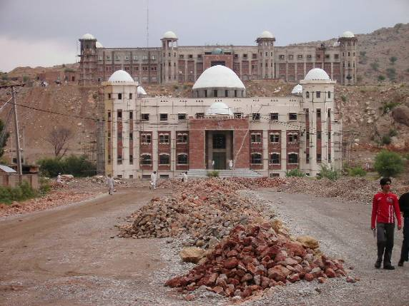
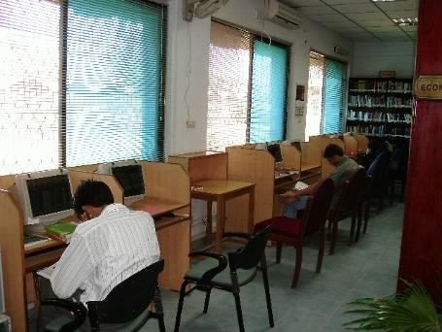

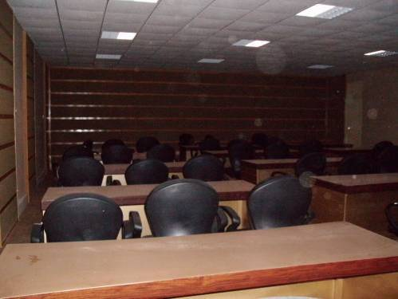
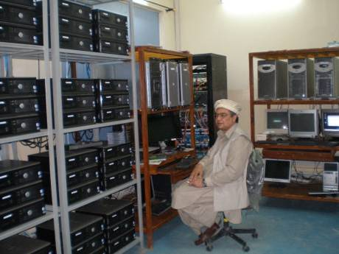
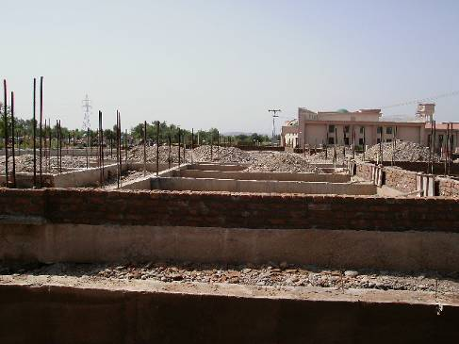
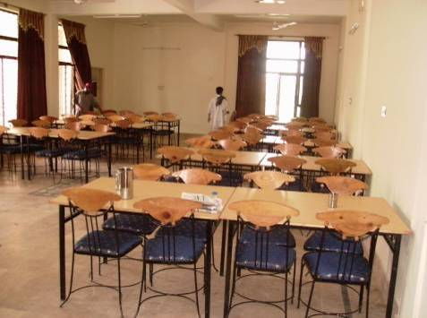
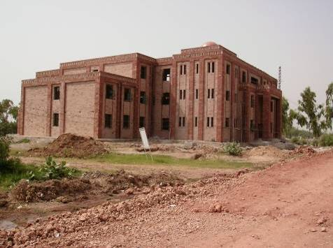
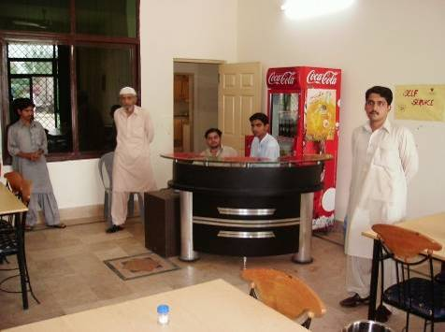
Kohat University of Science & Technology
Central Library
Video Conferencing Room
Cluster Room
Girls Hostel 250 Students
Girls Hostel 200 Students
Student Service Centre
Notes:
8

Slide 9
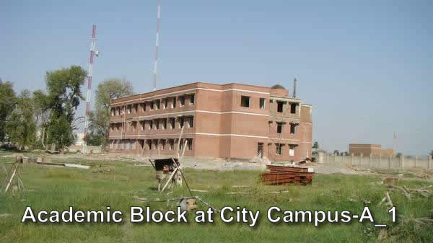
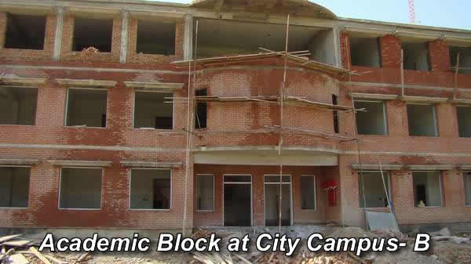
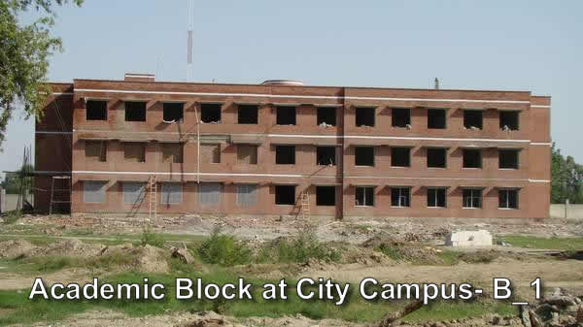
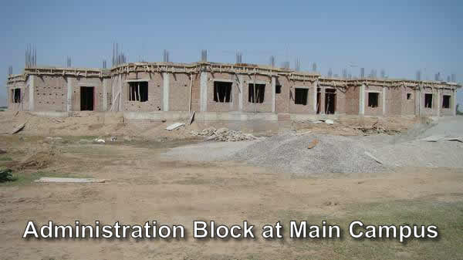
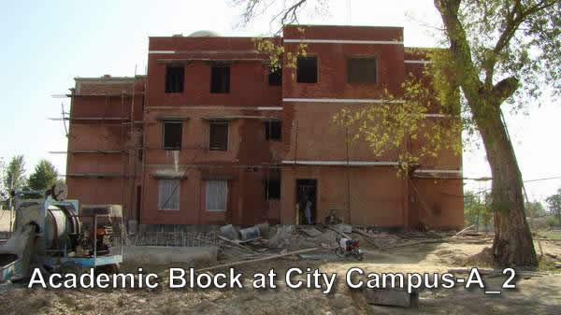
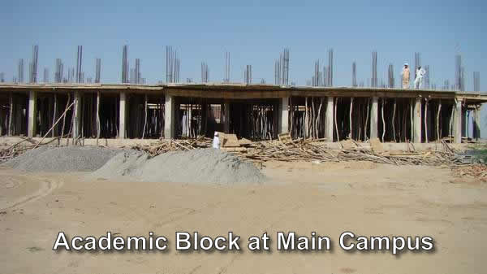
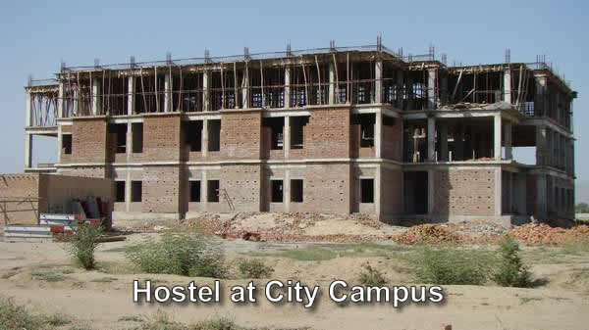
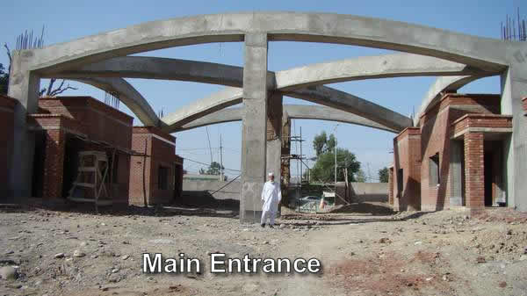
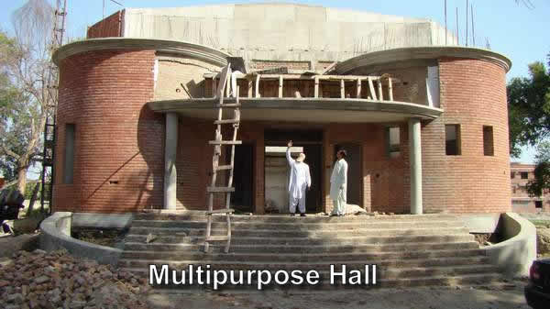
University of Science & Technology, Bannu

Slide 10
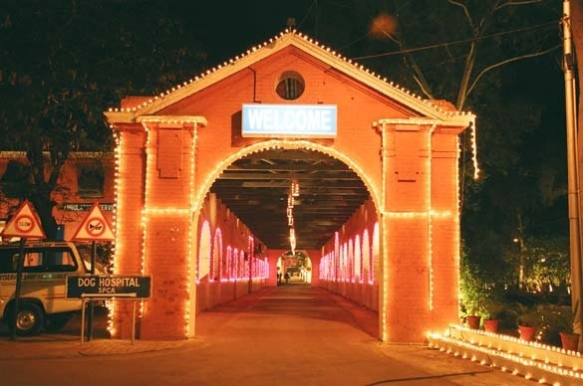
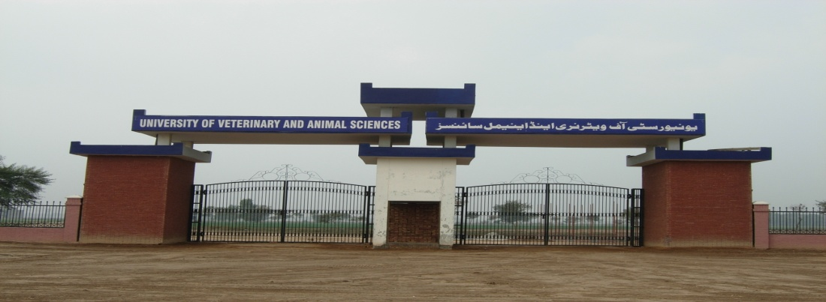
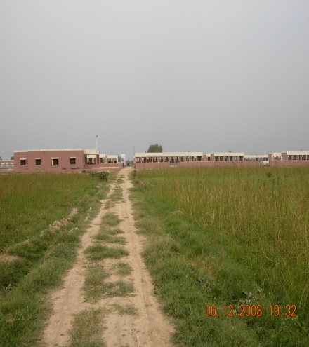
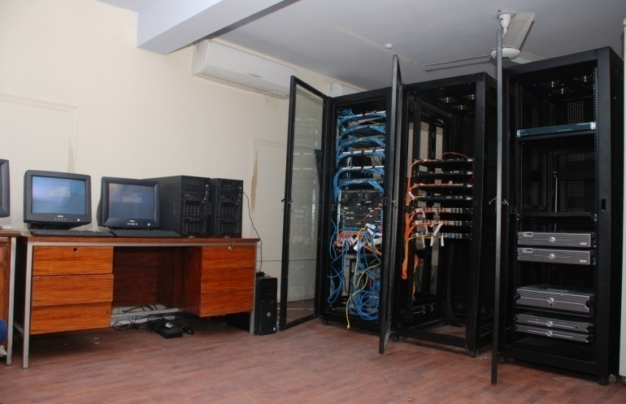

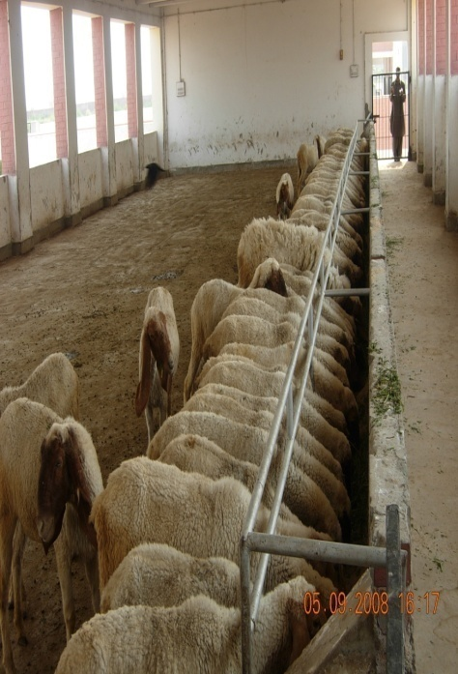
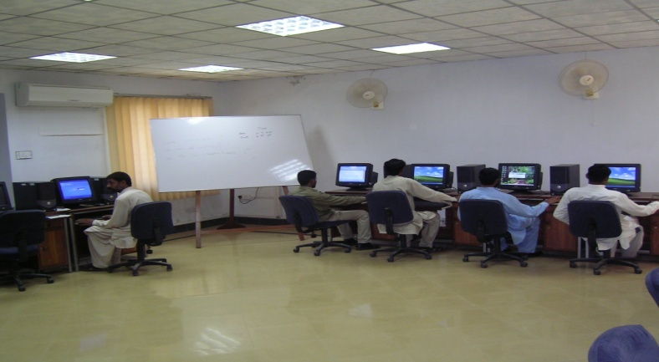
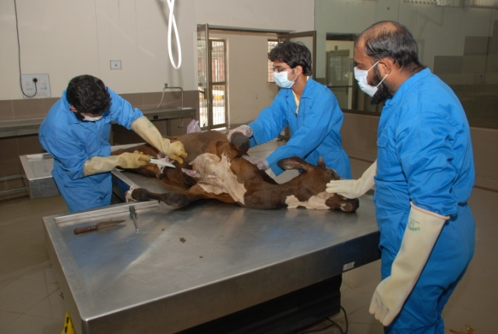
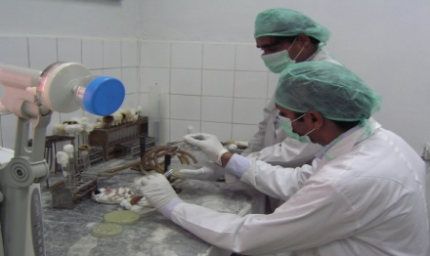
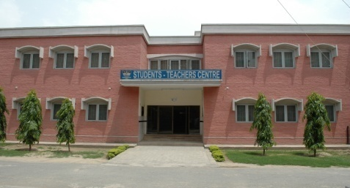
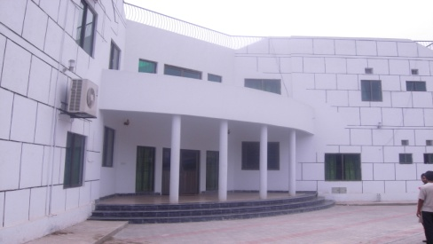
Notes:
10

Slide 11
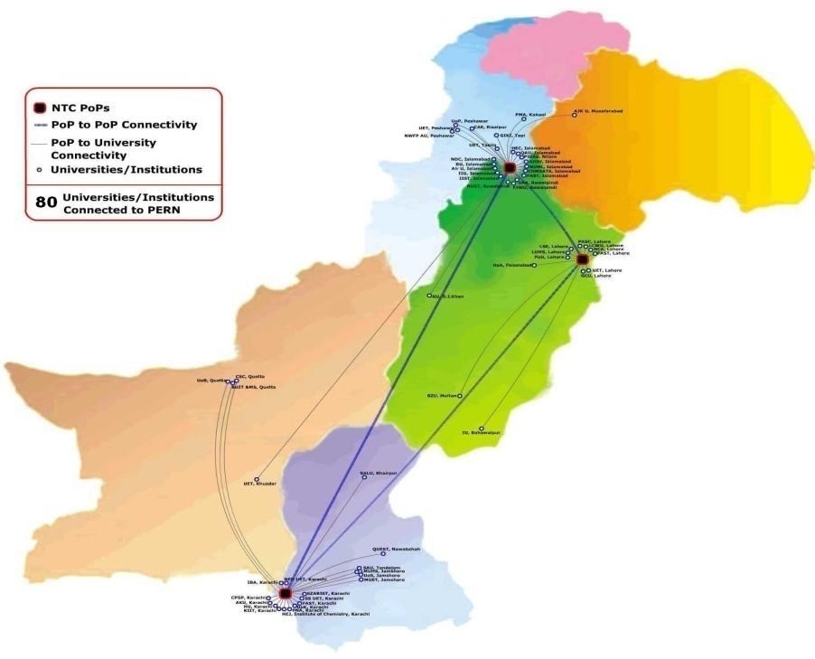
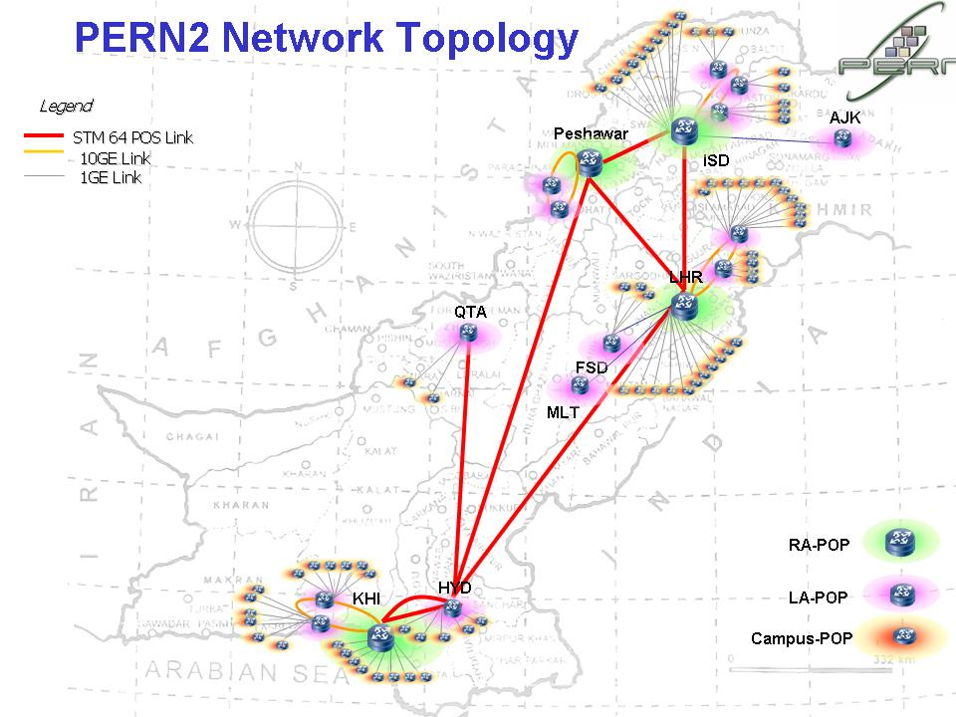
Pakistan Education & Research Network
PERN – I Status (2003 – 08)
Universities/ Institutes | 80
Core Bandwidth | 155 Mbps
Last Mile Bandwidth | 4-24 Mbps
International Leased Circuit | 155 Mbps
PERN – II Plans (2009 - 2013)
Universities/ Institutes/R&E Org. | 250+
Core Bandwidth | 10 Gbps
Last Mile Bandwidth | 1 Gbps
International Leased Circuit | 1.3 Gbps

Slide 12
Relevance to National Economy & Regional Needs
Date Palm Research Centre at Shah Abdul Latif University, Khairpur
Fruit and Vegetable Processing, Sindh Agricultural University, Tandojam
Food Technology, University of Agriculture, Faisalabad
Advance Manufacturing Engineering at UET Lahore
Earthquake Engineering Centre, UET Peshawar & NED, Karachi
Gemstone Training Centre at UET Peshawar
Institute for Sustainable Halophyte Utilization, University of Karachi
Lab for Nuclear Physics, QAU, Islamabad
National Institute of Vacuum Sci, QAU, Islamabad
Product Development Centre at NED
Notes:
12

Slide 13
Distribution of Approved Project Cost
Notes:
13

Slide 14
Sector-wise Development

Slide 15

QUAID-I-AZAM UNIVERSITY

Slide 16
INTRODUCTION
16
Established as University of Islamabad in July 1967
Renamed as Quaid-i-Azam University in 1976
Program Offered:
M.Sc.
M.Phil.
Ph.D.
No. of Faculties: 03
No. of Departments/Institutes 24

Slide 17
INTRODUCTION
Quaid-i-Azam University is well-known for its accomplishments in promoting excellence in science, technology and education.
Our University Partnership initiatives contribute to enhancing investment in the professional growth of faculty and students through grants, competitions and various academic enrichment programs.
QAU also engages academia in the research- and education-related activities

Slide 18
STUDENTS ENROLLED DURING LAST FIVE YEARS
80% of QAU faculty is with Ph.D

Slide 19
FACULTY DEVELOPMENT
Foreign Scholarship Program
Foreign Faculty Hiring
Tenure Track System
BPS Incentives

Slide 20
INTERNATIONALIZATION OF QAU
Curriculum
Students & Faculty Exchange
Joint Ventures

Slide 21
UNIVERSITY DEVELOPMENT – OFFICES ESTABLISHED
Quality Enhancement Cell
Financial Aid Office
University Advancement Office
Legal Section in Registrar’s Office

Slide 22
FUTURE PLANNING
Focus on Faculty Development (Training/ Research)
Hiring Faculty from outside
BS Programs of Studies
Quaid-i-Azam School of Business Management (Under Public Private Partnership Arrangement)
School of Economics
School of Mathematics

Slide 23
Challenges
Terrorism
Financial constraints
Inability to involve industry
Linking Research to local needs
Difficulties to attract and retain the qulaity Faculty/Researchers

Slide 24
QAU is ready to develop linkages with our foreign partners
We are already on the agenda of Internationalization
We are ready…..what about you?
Thanks

